Slide 1
Do Boundary Layer Eddy Size Distributions Link to Cumuliform Cloud Populations Deepening?
Scott W. Powell (scott.powell@nps.edu)
Dept. of Meteorology, Naval Postgraduate School, Monterey, CA
2023 AGU Fall Meeting, A12C-05
11 December 2023
Background image produced using DALL-E 3
Work presented in this talk has been supported the U.S. Department of Energy Atmospheric System Research, an Office of Science Biological and Environmental Research program, under Interagency Agreement 89243021SSC000077 and by the Office of Naval Research Code 32 under grant N0001423WX00360.

Slide 2
Wide cloud: More protected from environmental air
Narrow cloud: Diluted updraft
x
x

Slide 3
Powell (2023)
Red: Growers (reached at least 6000 m)
Blue: Non-Growers (started ascending in cloud but stopped between 2000 and 3500 m)
Parcel trajectories only shown when in cloud.

Slide 4
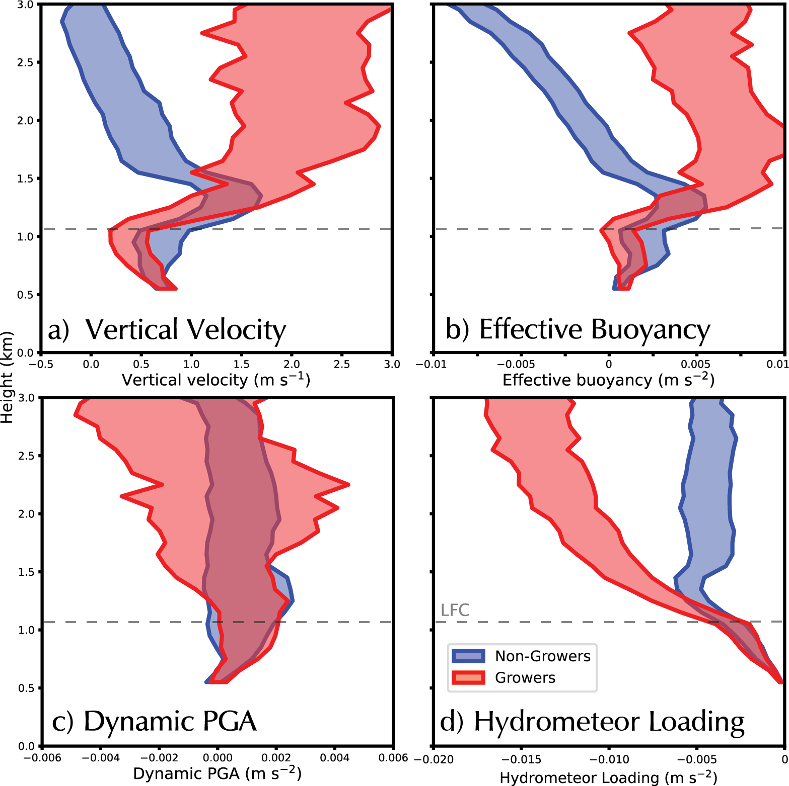
Red = Growers
Blue = Non-Growers
Growers are more buoyant above the LFC.
Growers and non-growers experience similar accelerations below the LFC.
https://nam10.safelinks.protection.outlook.com/?url=https%3A%2F%2Fwww.overleaf.com%2Fproject%2F6500ddbfec7988a5c3556ec6%2Finvite%2Ftoken%2F80eba7aef6f31acad489f98ad0ae3e1e3779a58326d63c0c%3Fproject_name%3DThesis%26user_first_name%3Dj13.wass&data=05%7C02%7Cscott.powell%40nps.edu%7C335bbcfaad0142f6dbeb08dbf9ee6a0d%7C6d936231a51740ea9199f7578963378e%7C0%7C0%7C638378574638673471%7CUnknown%7CTWFpbGZsb3d8eyJWIjoiMC4wLjAwMDAiLCJQIjoiV2luMzIiLCJBTiI6Ik1haWwiLCJXVCI6Mn0%3D%7C3000%7C%7C%7C&sdata=TRS%2BbThL%2B4kQhyeeT1FymNpjUPpHTYAhoQWBQGw7A8o%3D&reserved=0

Slide 5
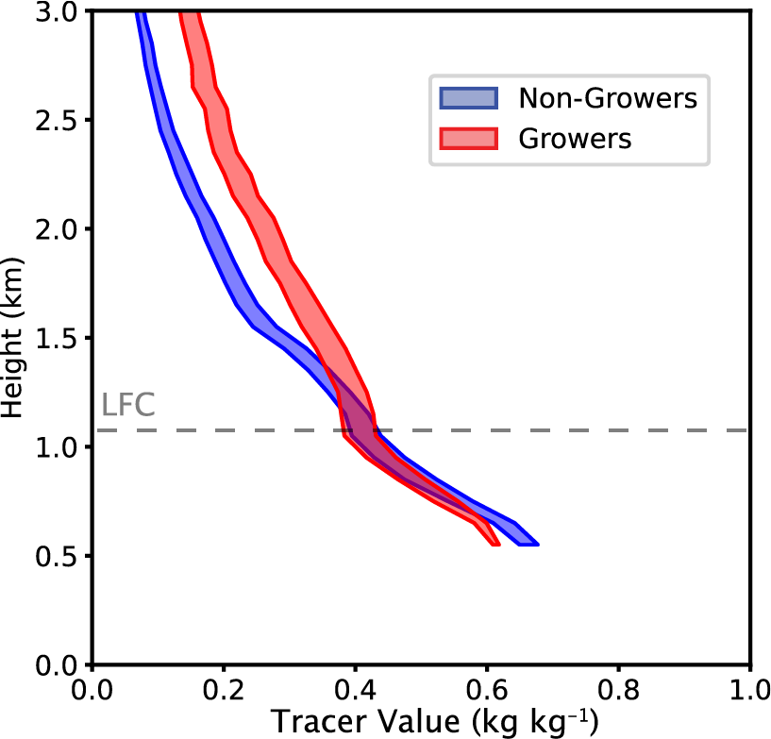
Red = Growers
Blue = Non-Growers
Growers are less diluted above the LFC.

Slide 6
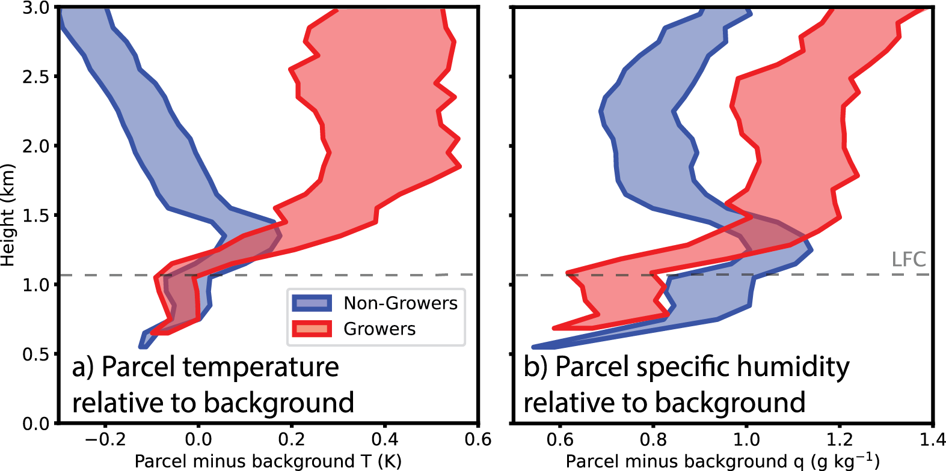
Red = Growers
Blue = Non-Growers
Growers are no warmer than non-growers below the LFC but they may occur in slightly moister environments.

Slide 7
Red = Growers
Blue = Non-Growers
Growers are located in wider updrafts and clouds than non-growers. This is true all the way down to cloud base!

Slide 8
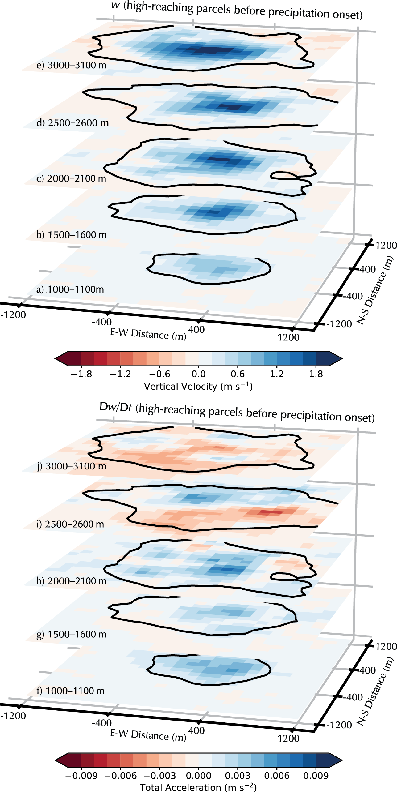
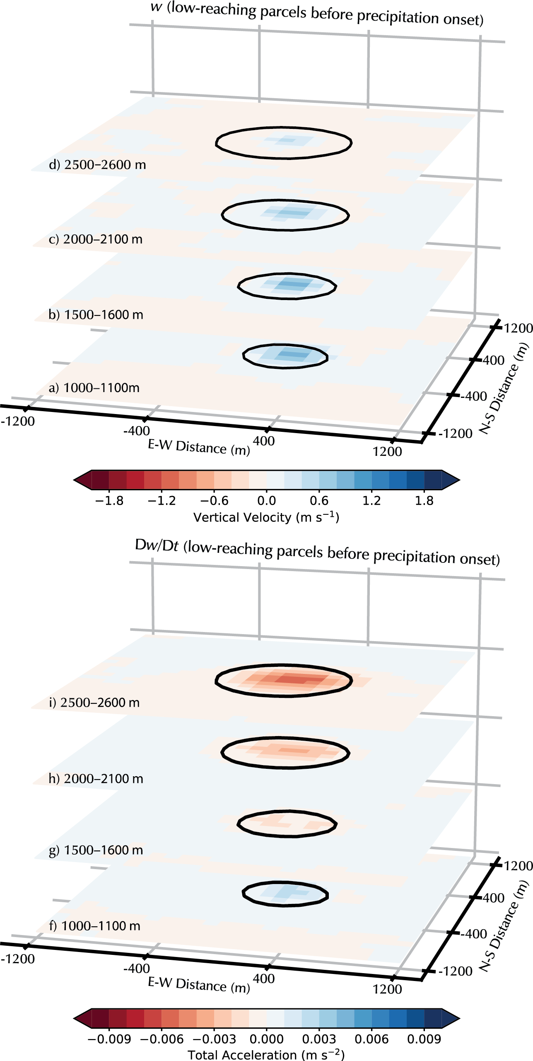
Right: Non-Growers
Left: Growers
Vertical Velocity (w)
Vertical Acceleration (Dw/Dt)

Slide 9
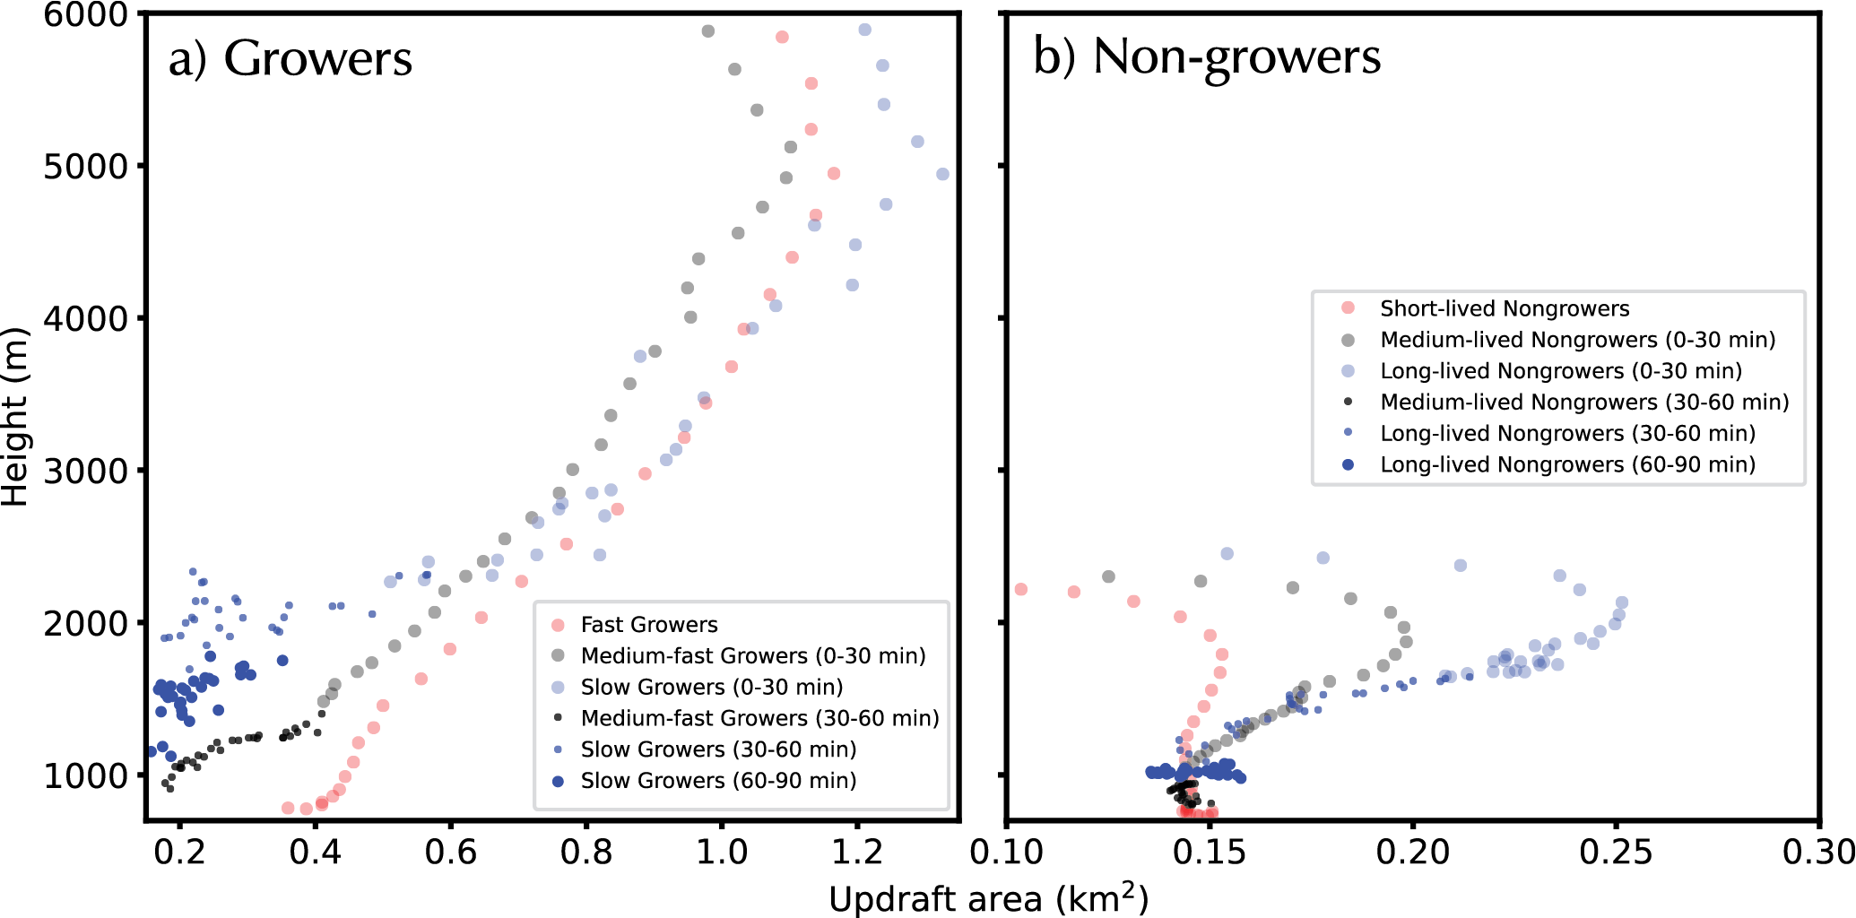
Growers did not begin ascending until they were present in an updraft with an area that exceeding a critical size.

Slide 10
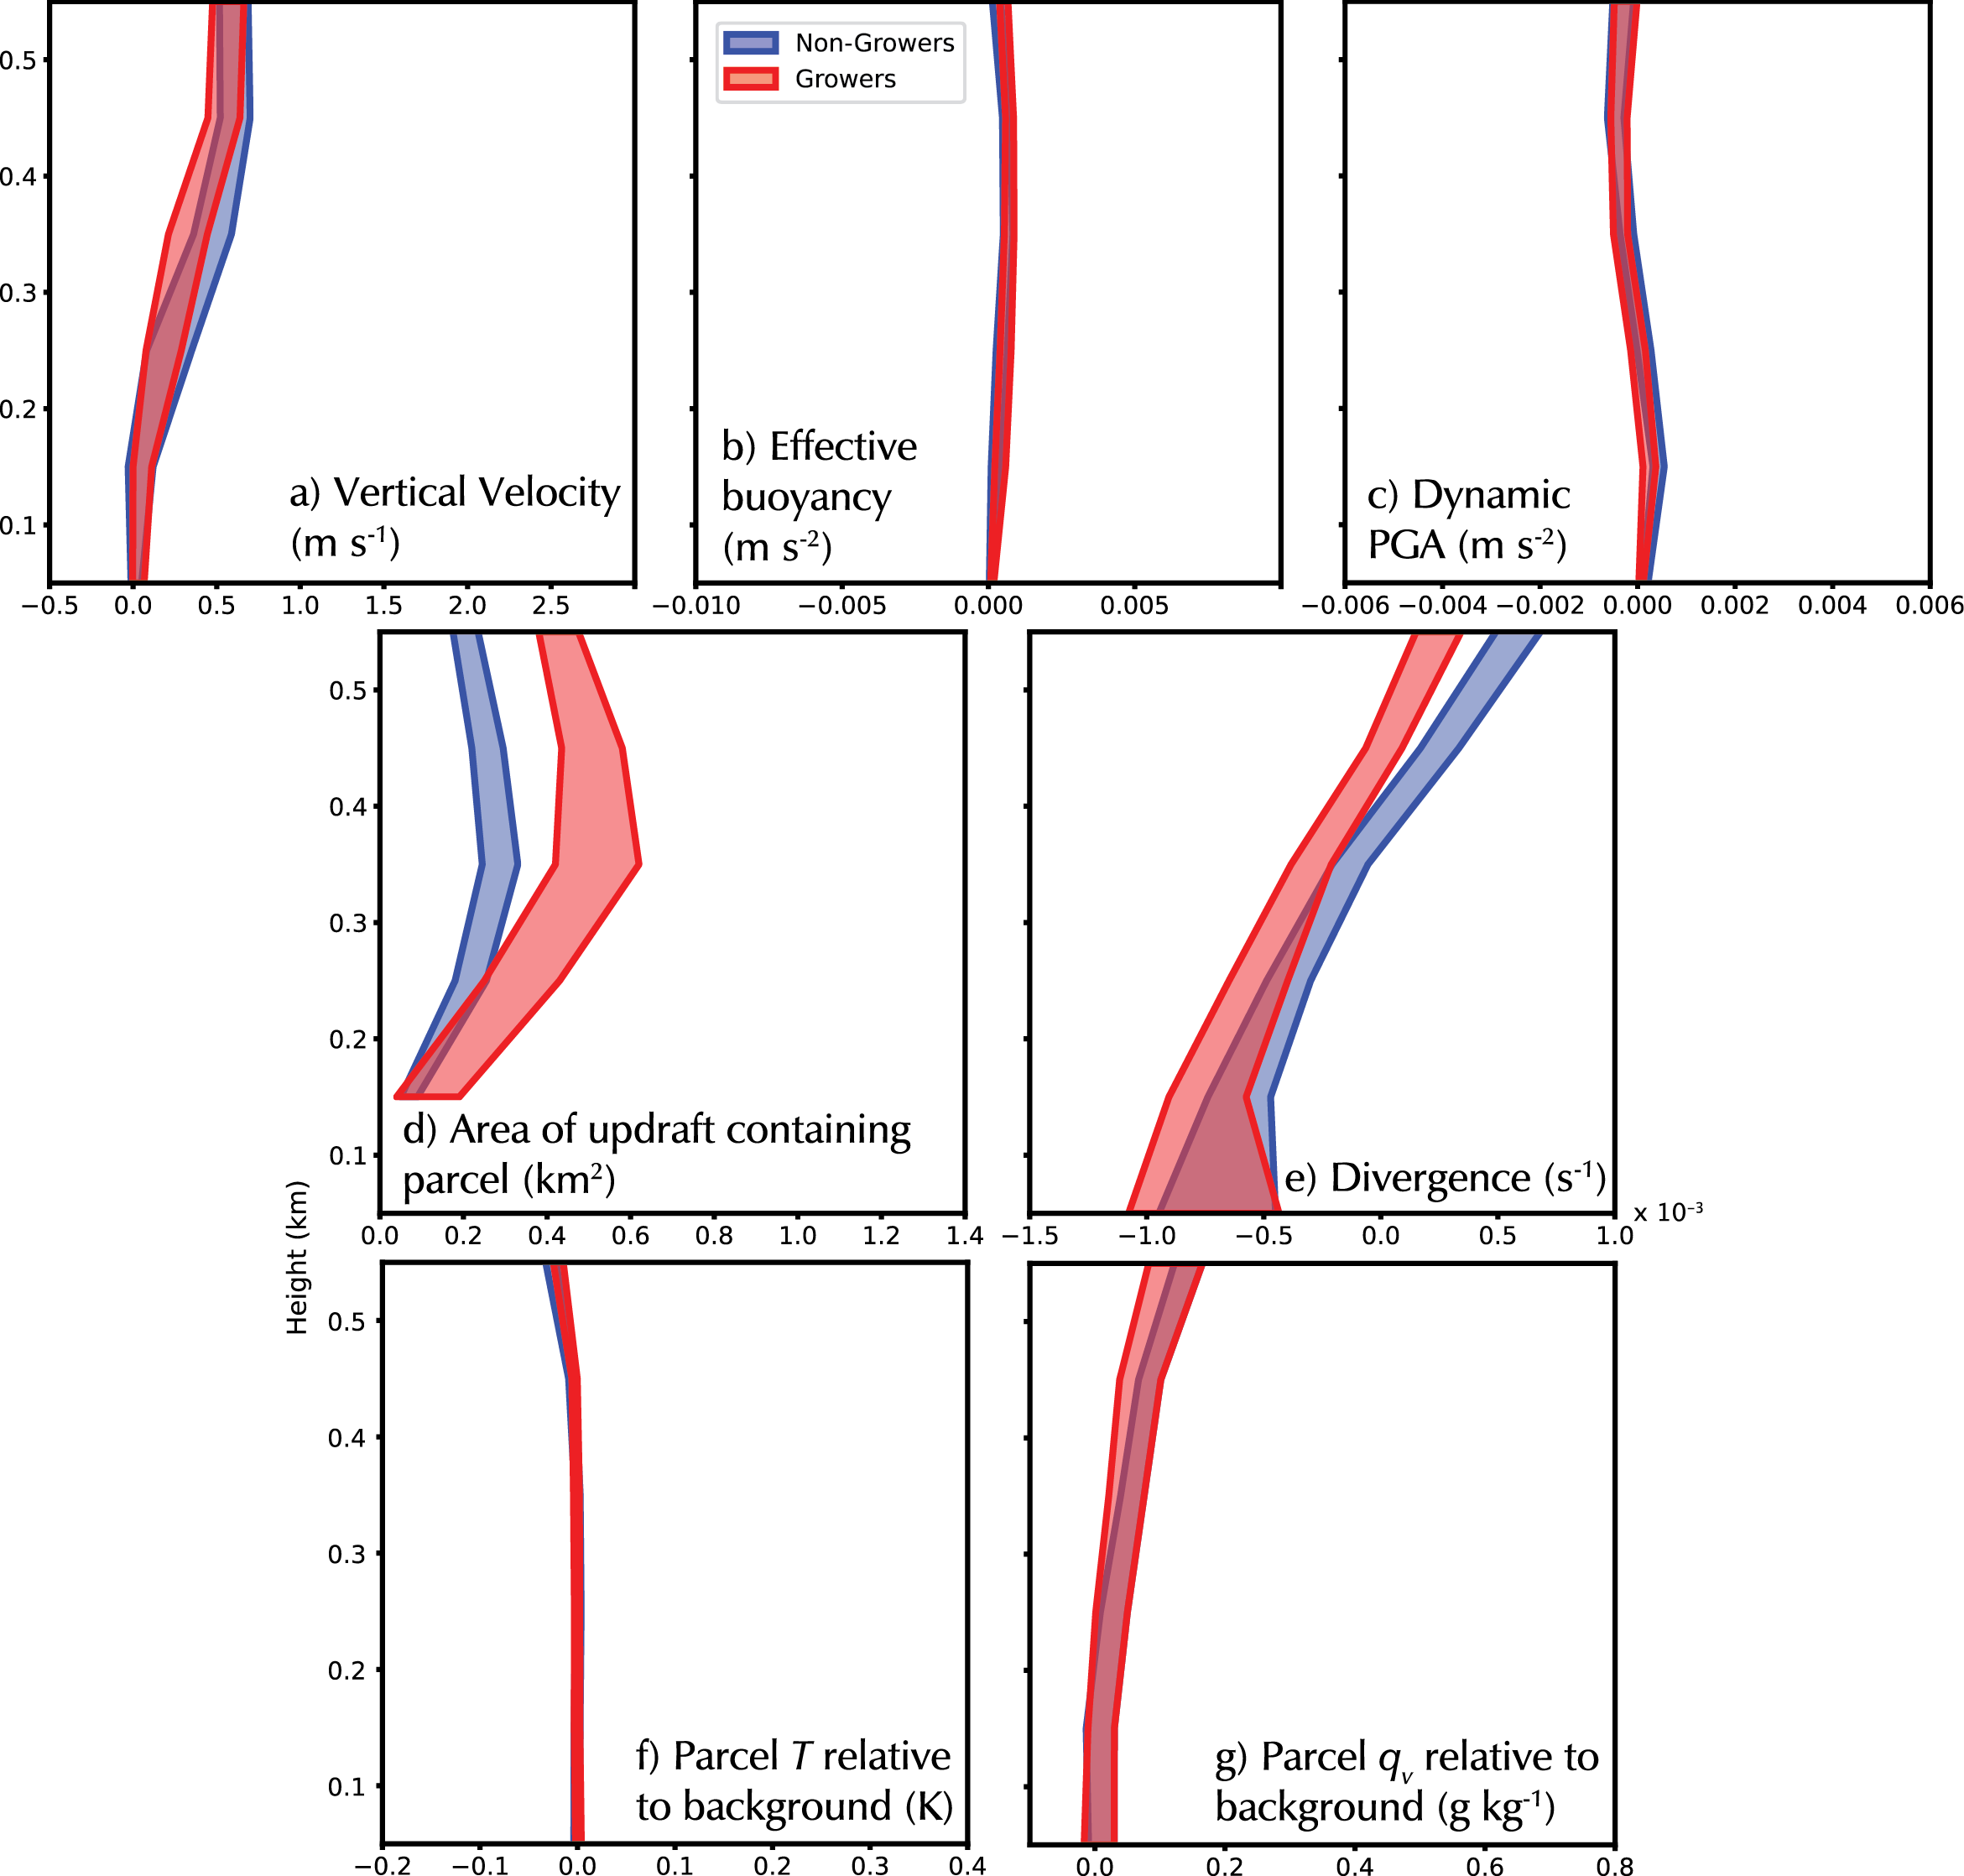
Red = Growers
Blue = Non-Growers
Growers were not thermodynamically different that non-growers in the sub-cloud layer but they did occur in wider eddy updrafts and in regions of more convergence (less divergence).

Slide 11
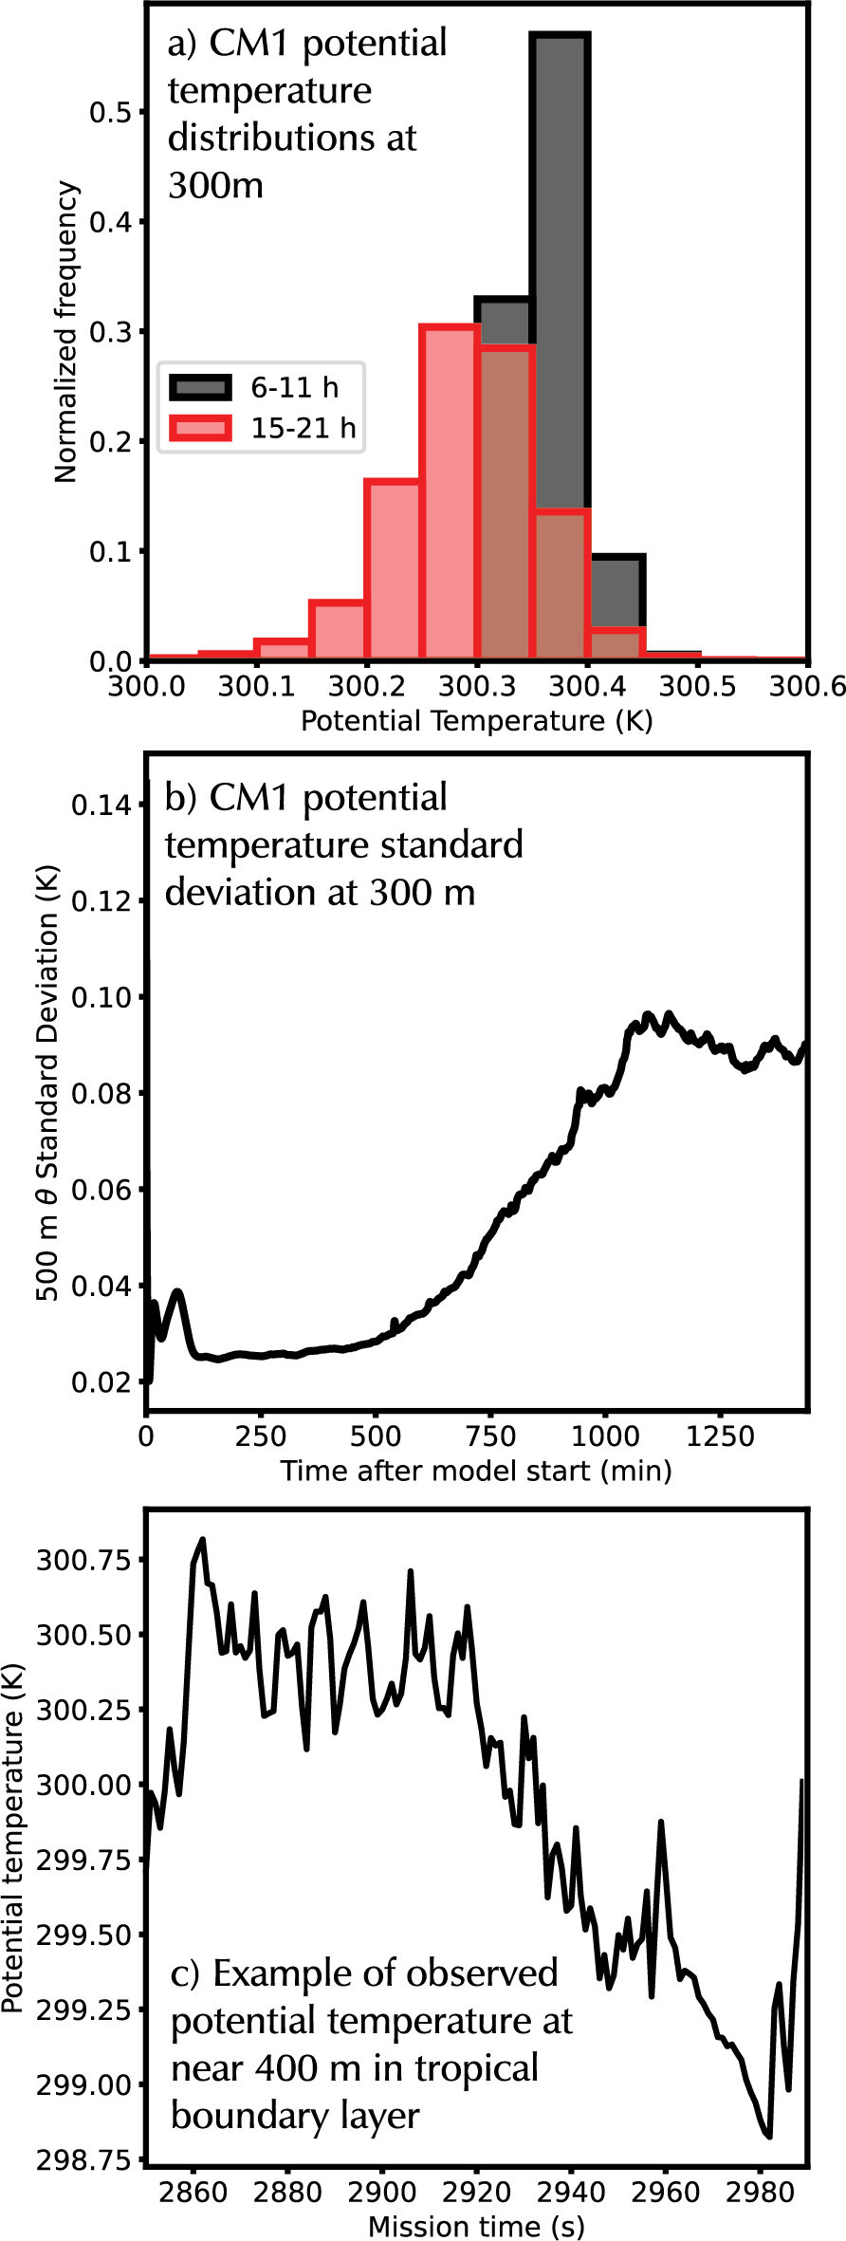
Caveat: The boundary layer thermodynamic fields in the simulation did not contain realistic heterogeneity.

Slide 12
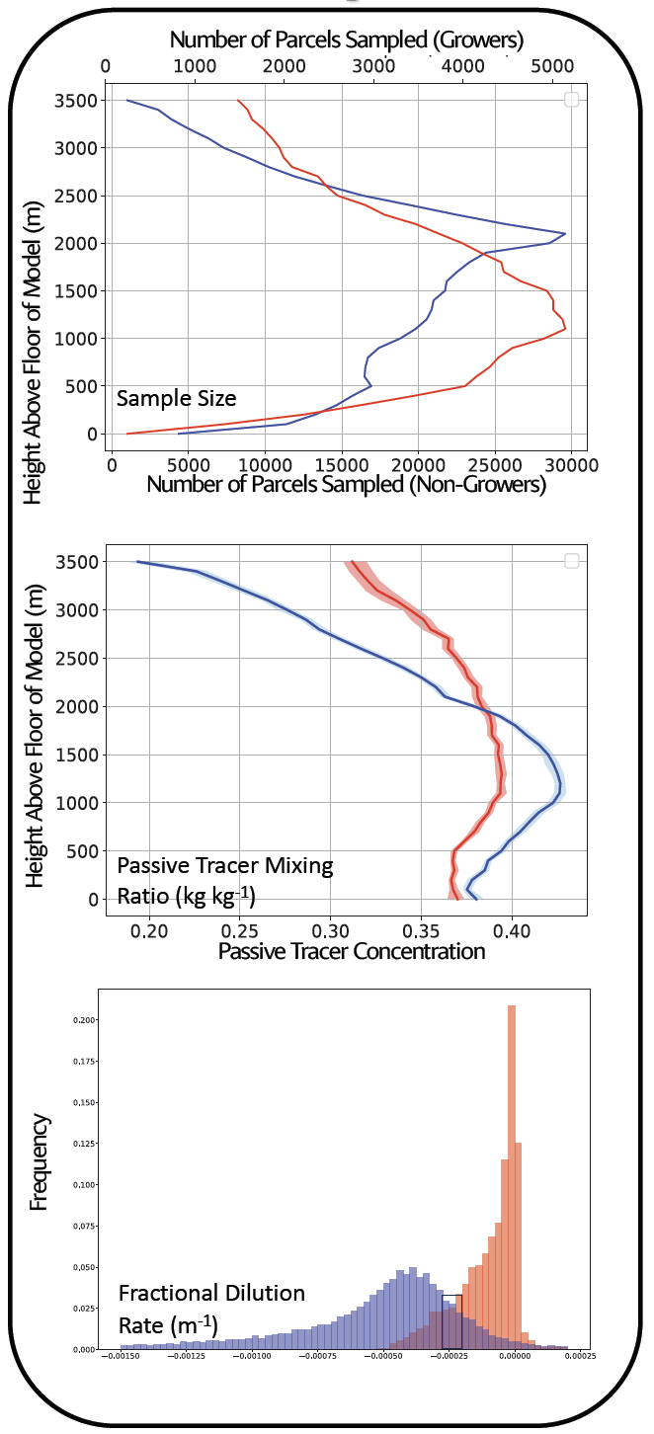
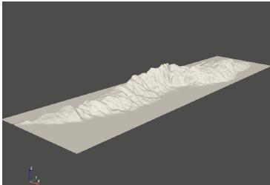
Bazemore and Powell (Poster A23H-2466)
Tuesday PM Session
Terrain-induced updrafts
0

Slide 13
Conclusions
In a LES experiment producing a population of tropical marine convection:
Parcels that ascended in cloud to 6000 m (growers) were separated from those that started to ascend in cloud but stopped between 2500 and 3000 m (non-growers).
Below the LFC, growers and non-growers experienced similar buoyancy and pressure gradient accelerations. However, growers experienced were less diluted and experienced positive buoyancy above the LFC.
Growers were located within wider updrafts and clouds down to the LCL. Parcels would generally not ascend to 6000 m until they were located within an updraft that was at least some minimum size.
Growers were also located in wider eddy updrafts and in regions of enhanced convergence below cloud base. Does divergence/convergence magnitude partially control BL eddy size?

