Slide 1
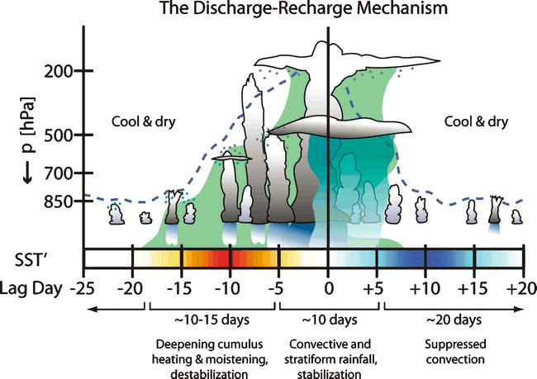
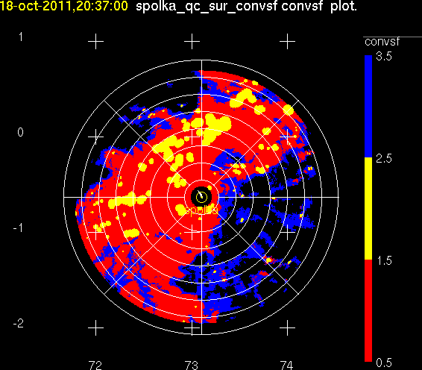
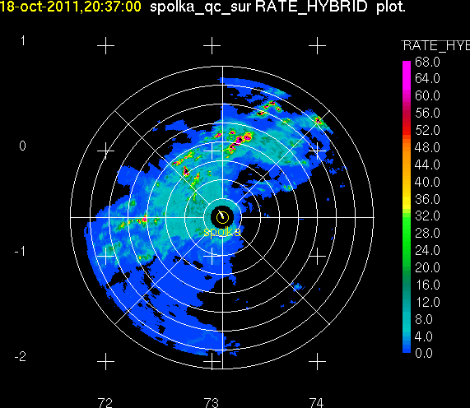
The Cloud Population and Onset of the Madden Julian Oscillation over the Indian Ocean during DYNAMO-AMIE
1. Introduction
5. Convection and Humidity
Scott W. Powell and Robert A. Houze, Jr.
University of Washington, Seattle, WA
Echo-top Heights and Humidification
Two hypotheses concerning onset of convection in association with the MJO are examined. Both ideas have been supported by many subsequent studies.
Knutson and Weickmann (1987) show evidence that an equatorial Kelvin wave response to one convective event circumnavigates in the upper-troposphere as a velocity potential anomaly, exciting the next event.
Bladé and Hartmann (1993) point out that no dynamical link exists between upper level wind anomalies and formation of lower-tropospheric convergence. They propose a “discharge-recharge” mechanism: Convection and humidity feedback onto each other, thus allowing humidity to slowly build vertically as convection becomes gradually taller in the 10 to 20 days prior to a convective event.
Time series of PDF for 20 dBZ echo top heights smoothed into three-day intervals. Red line follows the modal distribution.
Time series of q*’ smoothed to three-day intervals. Black line is the same as red line in (a). Contours are Eulerian derivative of q*’.
4. Radar and Rawinsonde Observations
Organization of observed convection
Three MJO-related convective events were observed. Generally, convectively generated rainfall contributed to about half of total during widespread stratiform events.
Isolated echoes
Echo Clusters
Squall lines
Widespread Stratiform
December event not as well-sampled; deepest convection formed east of S-PolKa. Also, horizontal extent of stratiform regions was smaller in December; intense squall lines with smaller stratiform areas were favored.
Benedict and Randall (2007)
Areal coverage of precipitation echoes
High-frequency variability
- Rapid increase in convective echo top heights occurs at beginning of October and November convective events. Smaller increase observed more gradually in December. The period of moistening prior to a convective event lasts no more than 10 days. While episodes of moistening may occur even earlier (November and December), drying occurs before moistening begins again. This is clearly inconsistent with the “discharge-recharge” mechanism.
- The direct relationship between clouds and humidity is inconclusive. For three convective events, the increase in convective echo top heights occurred after (October), before (November), and during (December) the greatest increase in moisture through a deep layer.
a) Areal coverage of stratiform echo is maximum during Wheeler and Hendon (2004; hereafter WH) MJO Phase 2 and minimum during Phase 6, which is similar to Barnes and Houze (2013) . Convective echoes follow similar behavior.
b) We wish to study evolution of humidity and clouds in days prior to MJO onset. Thus, we composite in 3-day (to smooth over day-to-day variability) intervals relative to a Day 0, which is the maximum in the 20-60 day Fourier-filtered stratiform precipitation time series. A gradual increase in stratiform areal coverage is seen.
c-e) Each CE shows one or two rapid increases in areal coverage of stratiform echo that occur over 3-6 days. Because the duration of each convective event was different, the timing of the sharp increase relative to Day 0 is different. Thus the composite of 3 cases smoothes out the rapid change in the echoes actually observed!
Variability in precipitation on 2-day and 4- to 6-day time scales is observed in October and November respectively. Many studies attribute the variability to inertio-gravity and mixed Rossby-gravity or equatorial Rossby wave modes.
Composite by WH MJO Phase
Composite by lag interval
October
2. Objectives
Humidity on MCS Days and Non-MCS Days
November
December
Zuluaga and Houze (2013)
- Describe the structure and organization of convection prior to, during , and after a convective outbreak associated with the MJO.
- Investigate the relationship between convective clouds, humidification of the troposphere, and MJO onset.
- Explore potential impacts of large-scale equatorial modes on MJO-related convection over the Indian Ocean.
The composite structure of temperature over many rain events resembles that of an westward propagating inertio-gravity wave. Mixed-Rossby gravity modes are seen in reanalysis (not shown).
Echo-top Heights
Normalized PDFs of echo top heights for 3-day intervals. Modal distribution of echo-top heights is highest (~ 7.5 km) near Day 0.
b) Number of convective echoes (representative of either number of convective echo objects or their horizontal extent) binned by top height. Highest number of total echoes observed near Day 0.
c) Normalized PDFs of echo top heights. We examine the potential effect of equatorial waves on cloud depth during an active MJO convective event.
MCS (Non-MCS) Days: Defined as precipitation on preceding and following days being less (more).
PDF during MCS days is significantly different (p = 0.05) than during Non-MCS days. PDF during Non-MCS days is very similar to that during suppressed WH MJO phases 4-7.
Rawinsonde Time Series
- Humidity on both MCS days and non-MCS days is similar (greater than 70% below 500 hPa).
- Although echo top PDF for Non-MCS Days and suppressed WH MJO phases are very similar, differences in humidity during these days are statistically significant (p = 0.05) at the levels shaded in gray.
- Dynamical support , which probably varies dependent on equatorial wave modes, is more important than environment humidity for developing deep convection.
Time series of u’, v’, T’, and q*’ are shown below. Anomalies are computed relative to the time mean at each pressure level (binned to 5 hPa intervals) for the period shown. q*’ is the fractional difference from the time mean of specific humidity.
3. Radar-derived Products
6. Equatorial Kelvin Wave
- Convective/stratiform classification
- Steiner et al. (1995)
- Precipitation rates
- Hybrid polarimetric rain rate from S-Pol
Echo top Heights
- Derived from RHI sectors only
- 20 dBZ echo tops
- Derived by searching upward from the base of an
echo object and finding the first echo in a
contiguous echo object that is not at least 20 dBZ.
ERA-Interim reanalysis is used to extend rawinsonde dataset to evaluate three-dimensional wind field. Below is the 150 hPa u’. Black dashed lines correspond to phase speed of Kelvin wave, which is identifiable objectively and subjectively in 2-dimensional analysis of wind field.
CE1
26-30 day variability is seen in u’ and T’ at 150 hPa. Deep westerly anomalies observed in late November and mid-to-late December.
Warm and moist anomalies between 500 and 200 hPa correspond with convective events.
Dry, suppressed conditions in January.
CE2
23.4 m s⁻¹
CE3
10.7 m s⁻¹
Conclusions
Addu
Stratiform cloud dominates variability in cloud cover through stages of a convective event.
Convective cloud depth is not controlled solely by environmental humidity.
Rapid (~3-7 day) increase in humidity observed above 850 hPa, which closely corresponds with sharp increase in convective cloud top height.
Convection does not initiate until upper-tropospheric Kelvin anomaly reaches the central Indian Ocean.
Upper-level support for deep convection and large stratiform regions may be controlled by wave dynamics.
“Quasi-periodicity” may really only refer to the irregular interval at which upper-level support is present for MJO onset.
At Addu, an easterly anomaly precedes a westerly anomaly during each convective event. No such feature (of opposite sign) is observed to propagate from the west at lower levels. We propose that the large-scale changes in divergence and subsidence in the upper-troposphere (down to 300 hPa) caused by the Kelvin wave modulates the convection on MJO-related timescales.
The Kelvin wave appears to circumnavigate and excite convective events in October and November. Whether the signal continues to circumnavigate is unclear in the present analysis. Regardless of the source of the Kelvin mode, a convective event does not begin at Addu until the divergent upper-level anomaly approaches from the west.
S. Powell was supported by DOE grants DE-SC0001164/ER-64572 and DE-SC0008452 and NSF grant AGS-1059611.

