Slide 1
Are Equatorial Kelvin Waves Chickens? An Updated Paradigm for MJO Onset
Scott W. Powell
University of Washington
February 7, 2013

Slide 2
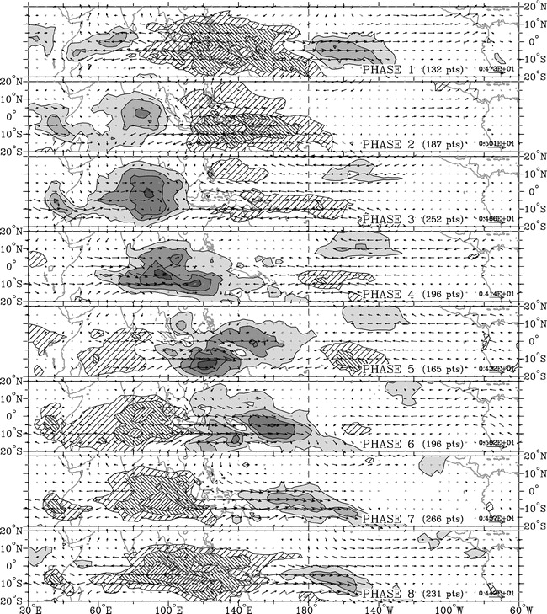
Wheeler and Hendon (2004)
Madden and Julian (1972)

Slide 3
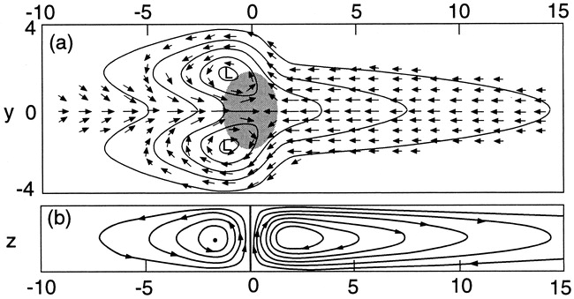
Houze et al. (2000); Salby (1996); Gill (1980)

Slide 4
Knutson and
Weickmann
(1987)

Slide 5
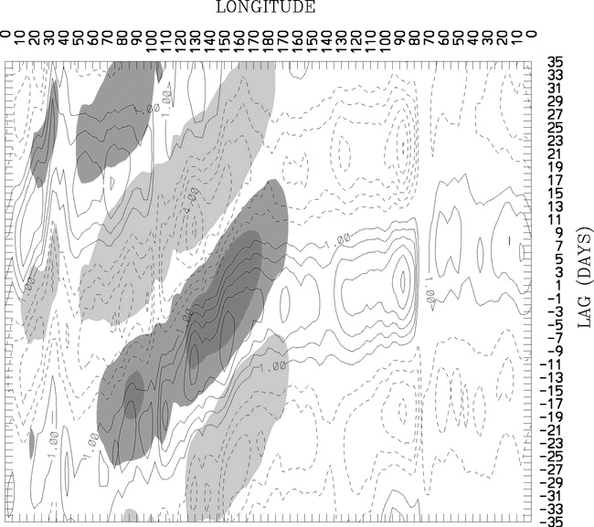
21 days
Kiladis et al. (2005)

Slide 6
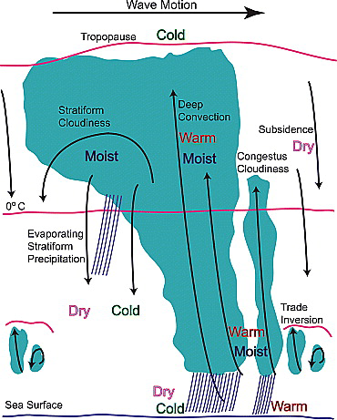
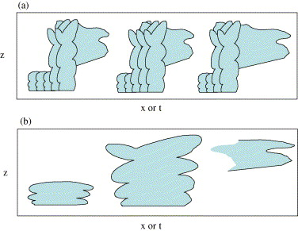
Mapes et al. (2006)
On what is time scale does this happen?
Kiladis et al. (2009)

Slide 7
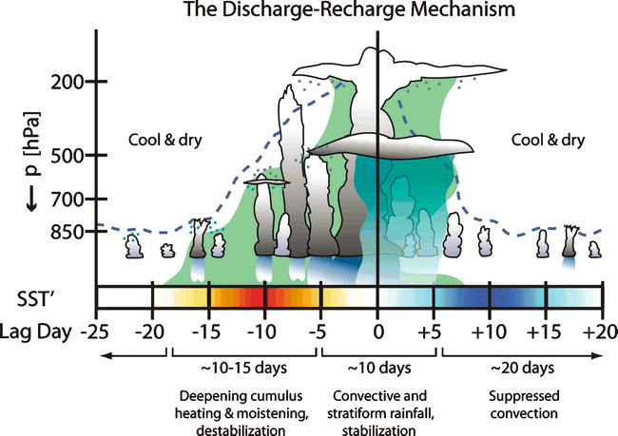
Bladé and Hartmann (1993); Kemball-Cook and Weare (2001); Benedict and Randall (2007)

Slide 8
TOGA COARE: Chen et al. (1996)
MISMO: Yoneyama et al. (2008)

Slide 9
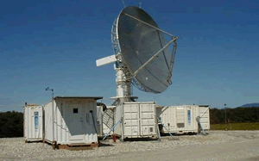
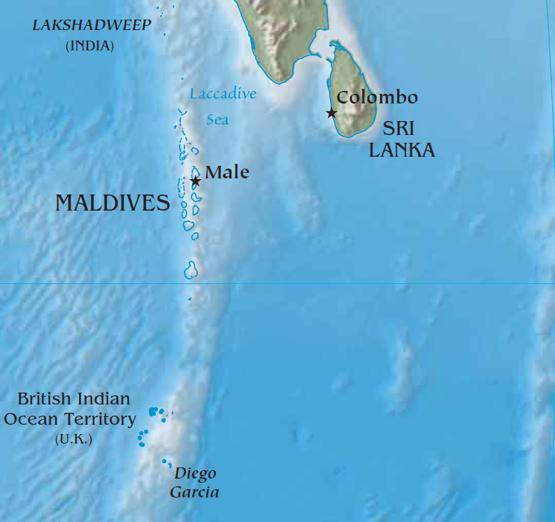
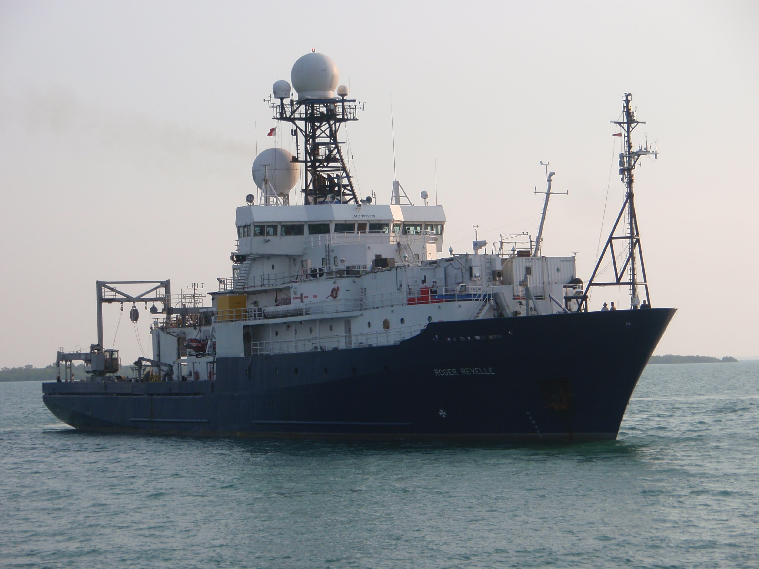
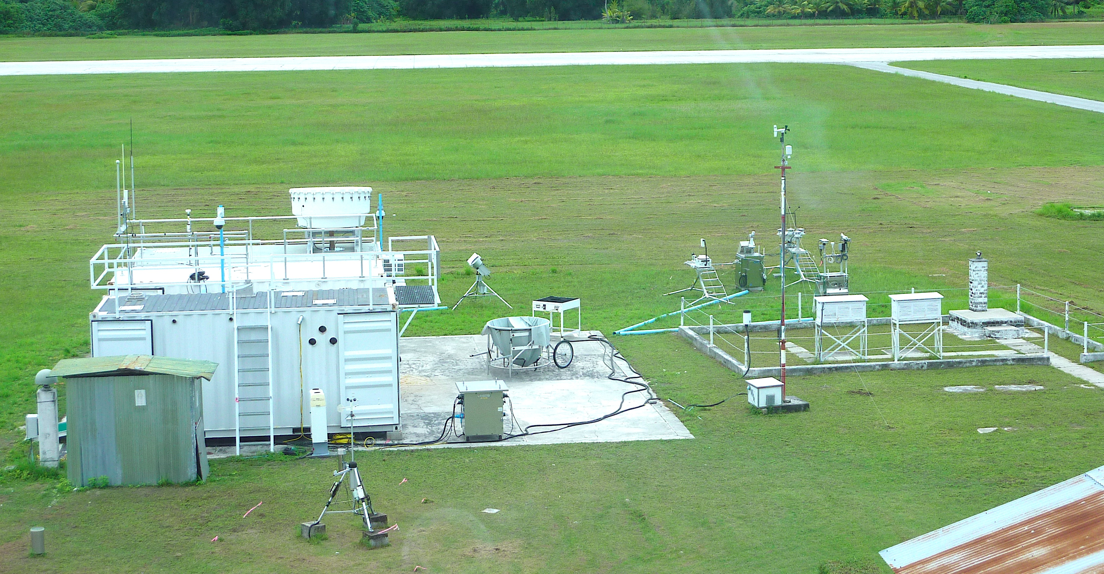
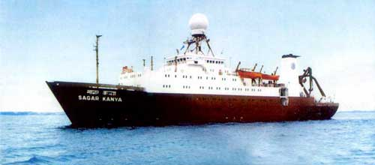
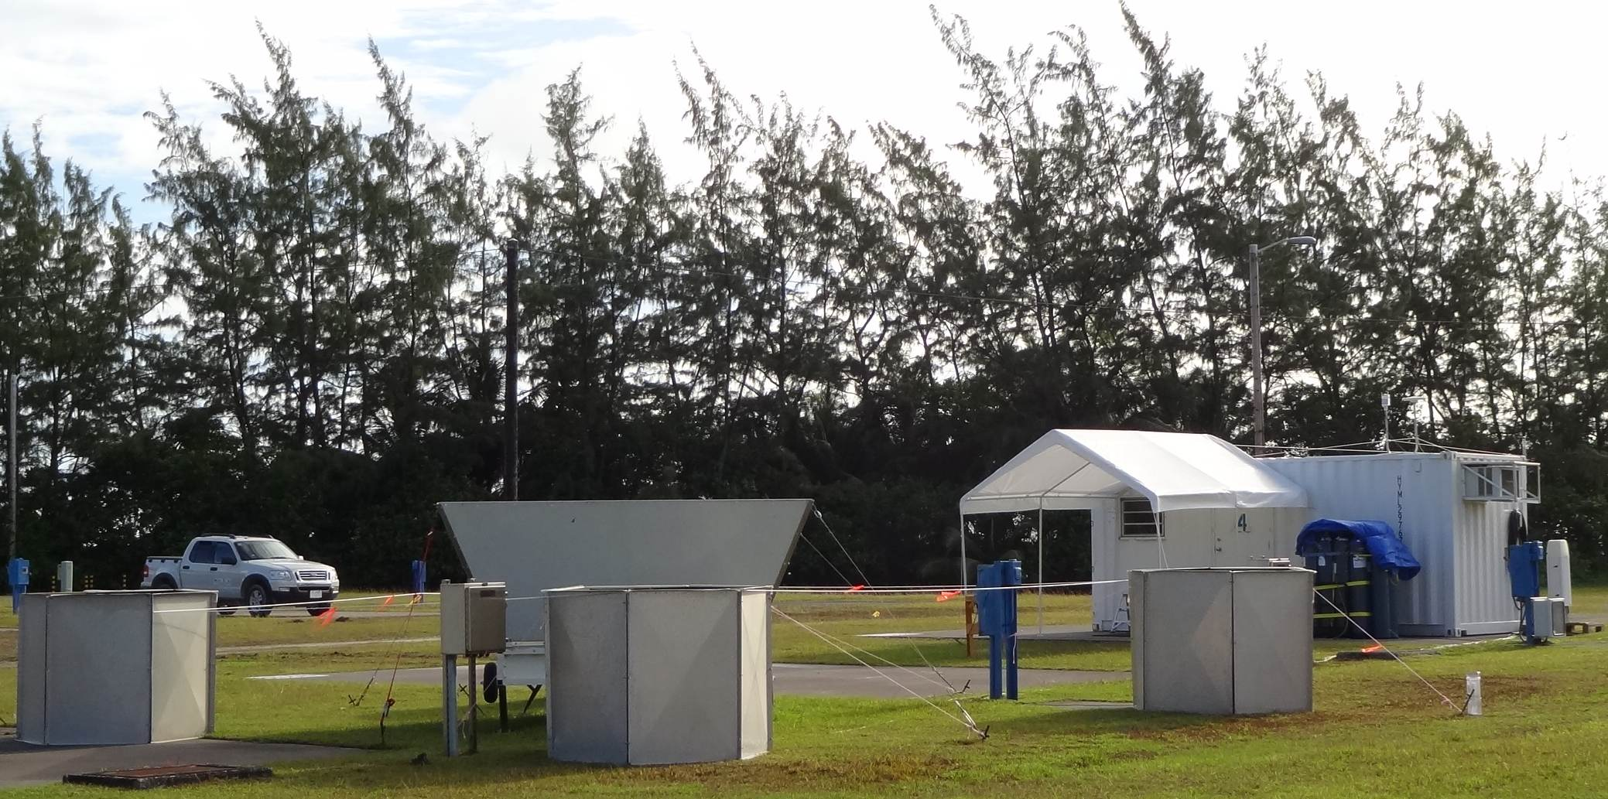
DYNAMO Field Experiment (October 2011 – March 2012)
Sounding Network
Falcon
S-PolKa
R/V B. Jaya-III
Male
SMART-R
R/V R. Revelle
Revelle
AMF2
Addu Atoll
ISS
R/V S. Kanya
P-3
Mirai
Slide: C. Zhang
R/V Mirai

Slide 10
Objectives
Describe structure and organization of convection.
Relationship between convective clouds, tropospheric humidification, and MJO onset.
Potential impacts of large-scale equatorial modes on convection.

Slide 11
Objectives
Describe structure and organization of convection.
Relationship between convective clouds, tropospheric humidification, and MJO onset.
Potential impacts of large-scale equatorial modes on convection.

Slide 12
Objectives
Describe structure and organization of convection.
Relationship between convective clouds, tropospheric humidification, and MJO onset.
Potential impacts of large-scale equatorial modes on convection.

Slide 13
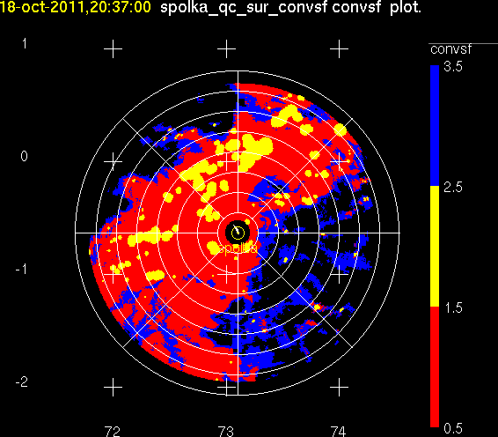
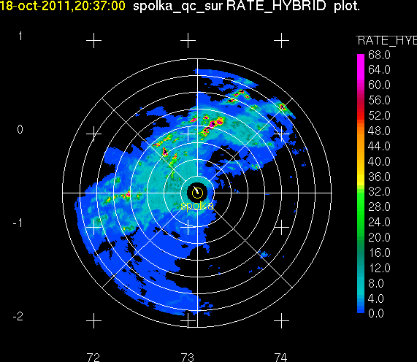
Radar-derived Products
Convective/Stratiform
Precipitation maps
20 dBZ echotop heights derived directly from reflectivity field.

Slide 14
Powell and Houze (revised for JAS)

Slide 15
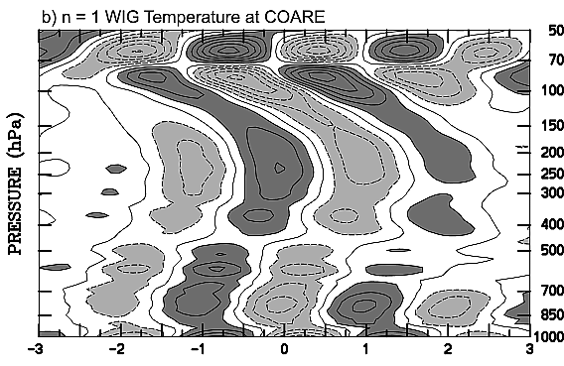
Mixed Rossby-gravity waves
- Phase speed westward
- Group velocity eastward
Θ’
Zuluaga and Houze (2013)
v’
Kiladis et al. (2005)

Slide 16
Variability in precipitating clouds
By MJO Phase (Wheeler &
Hendon, 2004)
Relative to filtered precipitation
maximum

Slide 17
Composite
CE1 (October)
CE2 (November)
CE3 (December)

Slide 18
Convective Cloud Echo Tops

Slide 19
Convective Cloud Echo Tops

Slide 20
Day to day variability in cloud depth

Slide 22
Convective cloud 20 dBZ PDF
Corresponding
RH profiles

Slide 23
3-day smoothing

Slide 24
Filtered q*’
Positive lags (in parenthesis) indicate
variable in column leads.

Slide 26
Filtered q*’
Positive lags (in parenthesis) indicate
variable in column leads.

Slide 27
ERA u’
Gan
ERA q*’

Slide 28
CE1
CE2
23.4 m s⁻¹
10.7 m s⁻¹
CE3

Slide 29
Figure: Matt Wheeler
Based on Wheeler and Hendon (2004)

Slide 30
Figure: A. Adames, paper in prep

Slide 31
Wave dynamics control cloud depth

Slide 32
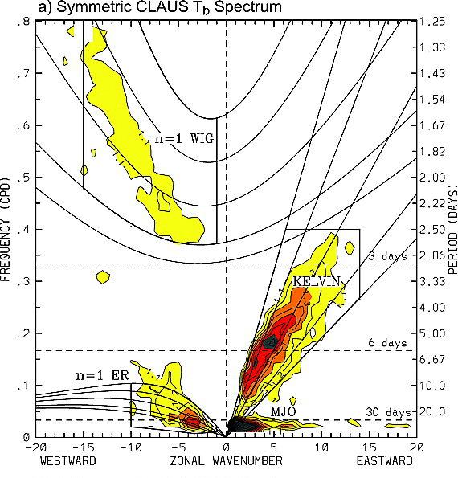
The misguided notion of “quasi-periodicity”
Kiladis et al. (2009)
u’
OLR

Slide 33
Conclusions
Stratiform cloud dominates variability in cloud cover
through stages of a convective event.
Convective cloud depth is not controlled solely by
environmental humidity.
Rapid increase in humidity observed above 850 hPa,
which closely corresponds with sharp increase in
convective cloud top height.
Convection does not initiate until upper-tropospheric
Kelvin anomaly reaches the central Indian Ocean.

Slide 34
Conclusions
Stratiform cloud dominates variability in cloud cover
through stages of a convective event.
Convective cloud depth is not controlled solely by
environmental humidity.
Rapid increase in humidity observed above 850 hPa,
which closely corresponds with sharp increase in
convective cloud top height.
Convection does not initiate until upper-tropospheric
Kelvin anomaly reaches the central Indian Ocean.

Slide 35
Conclusions
Stratiform cloud dominates variability in cloud cover
through stages of a convective event.
Convective cloud depth is not controlled solely by
environmental humidity.
Rapid increase in humidity observed above 850 hPa,
which closely corresponds with sharp increase in
convective cloud top height.
Convection does not initiate until upper-tropospheric
Kelvin anomaly reaches the central Indian Ocean.

Slide 36
Conclusions
Stratiform cloud dominates variability in cloud cover
through stages of a convective event.
Convective cloud depth is not controlled solely by
environmental humidity.
Rapid increase in humidity observed above 850 hPa,
which closely corresponds with sharp increase in
convective cloud top height.
Convection does not initiate until upper-tropospheric
Kelvin anomaly reaches the central Indian Ocean.

Slide 37
Conclusions, cont’d.
Upper-level support for deep convection and large stratiform regions may be controlled by wave dynamics.
“Quasi-periodicity” may really only refer to the irregular interval at which upper-level support is present for MJO onset.

Slide 38
Conclusions, cont’d.
Upper-level support for deep convection and large stratiform regions may be controlled by wave dynamics.
“Quasi-periodicity” may really only refer to the irregular interval at which upper-level support is present for MJO onset.

Slide 39
Conclusions
Stratiform cloud dominates variability in cloud cover through stages of a convective event.
Convective cloud depth is not controlled solely by environmental humidity.
Rapid increase in humidity observed above 850 hPa, which closely corresponds with sharp increase in convective cloud top height.
Convection does not initiate until upper-tropospheric Kelvin anomaly reaches the central Indian Ocean.
Upper-level support for deep convection and large stratiform regions may be controlled by wave dynamics.
“Quasi-periodicity” may really only refer to the irregular interval at which upper-level support is present for MJO onset.

Slide 40
This work was supported by the Department of Energy with grant DE-SC0008452.

